Slide 1

CHAPTER 9
COUNTING AND
PROBABILITY
Copyright © Cengage Learning. All rights reserved.

Slide 2
SECTION 9.4
The Pigeonhole Principle
Copyright © Cengage Learning. All rights reserved.

Slide 3
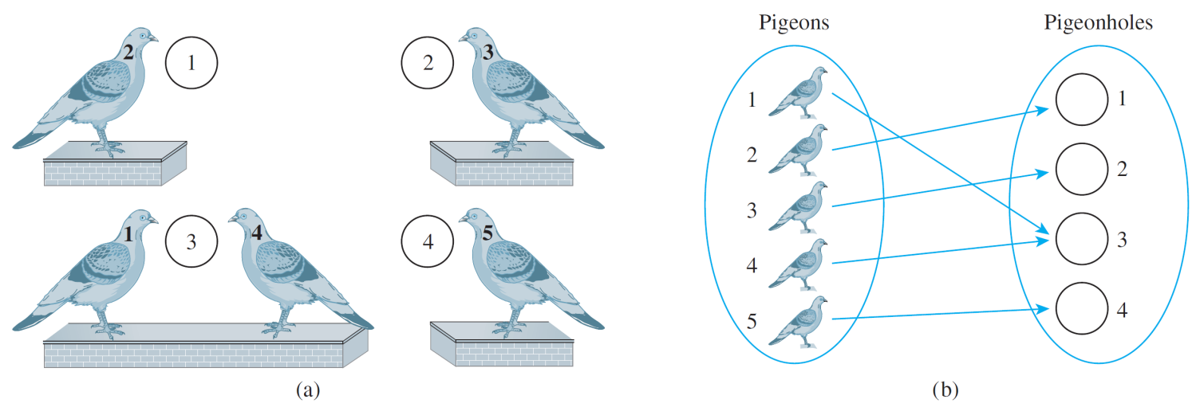
The Pigeonhole Principle
The pigeonhole principle states that if n pigeons fly into m pigeonholes and n > m, then at least one hole must contain two or more pigeons.
This principle is illustrated in Figure 9.4.1 for n = 5 and
m = 4.
(a)
(b)
Figure 9.4.1

Slide 4
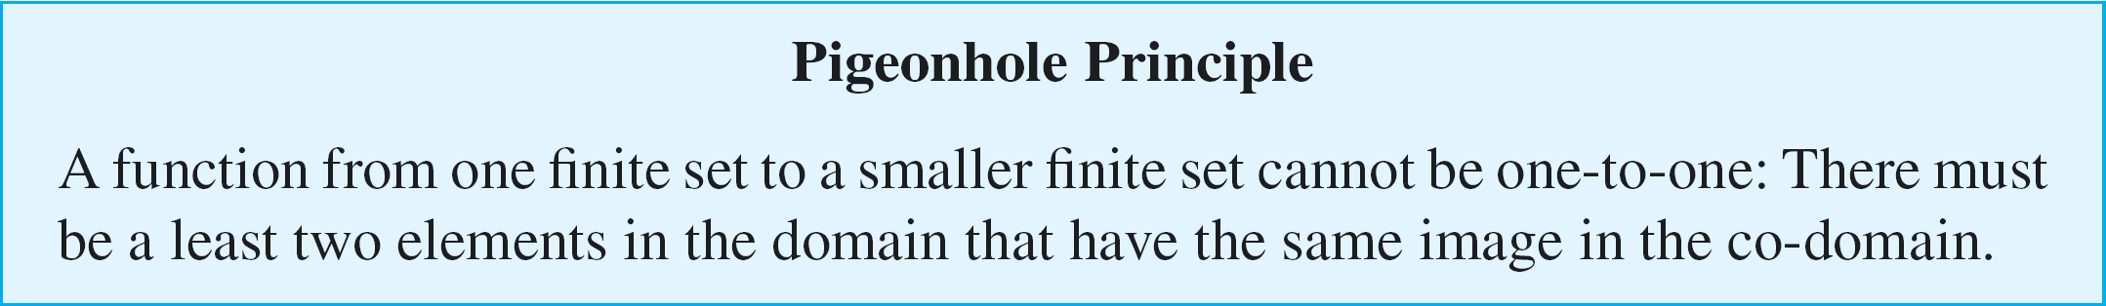
The Pigeonhole Principle
Illustration (a) shows the pigeons perched next to their
holes, and (b) shows the correspondence from pigeons to pigeonholes.
The pigeonhole principle is sometimes called the Dirichlet box principle because it was first stated formally by
J. P. G. L. Dirichlet (1805–1859).
Illustration (b) suggests the following mathematical way to phrase the principle.

Slide 5
Example 1 – Applying the Pigeonhole Principle
a. In a group of six people, must there be at least two who
were born in the same month?
In a group of thirteen people, must there be at least two
who were born in the same month? Why?
b. Among the residents of New York City, must there be at
least two people with the same number of hairs on their
heads? Why?

Slide 6
Example 1(a) – Solution
A group of six people need not contain two who were born in the same month. For instance, the six people could have birthdays in each of the six months January through June.
A group of thirteen people, however, must contain at least two who were born in the same month, for there are only twelve months in a year and 13 > 12.
To get at the essence of this reasoning, think of the thirteen people as the pigeons and the twelve months of the year as the pigeonholes.

Slide 7
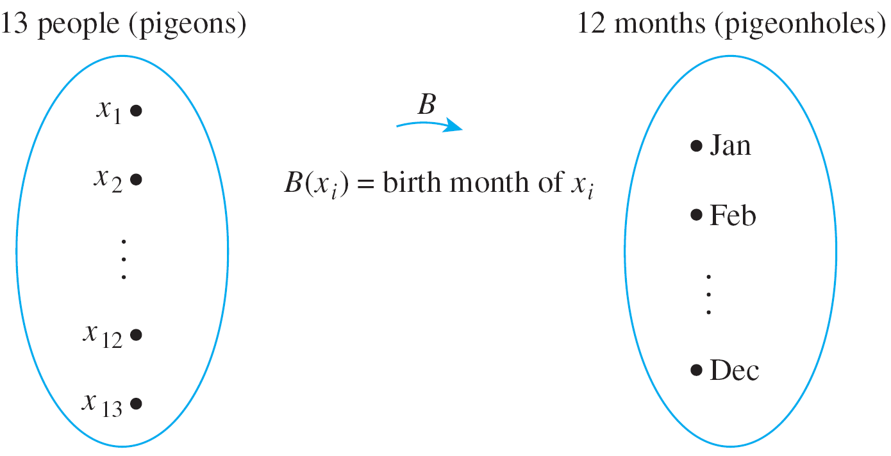
Example 1(a) – Solution
cont’d
Denote the thirteen people by the symbols x₁, x₂, . . . , x₁₃ and define a function B from the set of people to the set of twelve months as shown in the following arrow diagram.

Slide 8
Example 1(a) – Solution
cont’d
The pigeonhole principle says that no matter what the particular assignment of months to people, there must be at least two arrows pointing to the same month.
Thus at least two people must have been born in the same month.

Slide 9
Example 1(b) – Solution
cont’d
The answer is yes.
In this example the pigeons are the people of New York City and the pigeonholes are all possible numbers of hairs on any individual’s head.
Call the population of New York City P. It is known that P is at least 5,000,000.
Also the maximum number of hairs on any person’s head is known to be no more than 300,000.

Slide 10
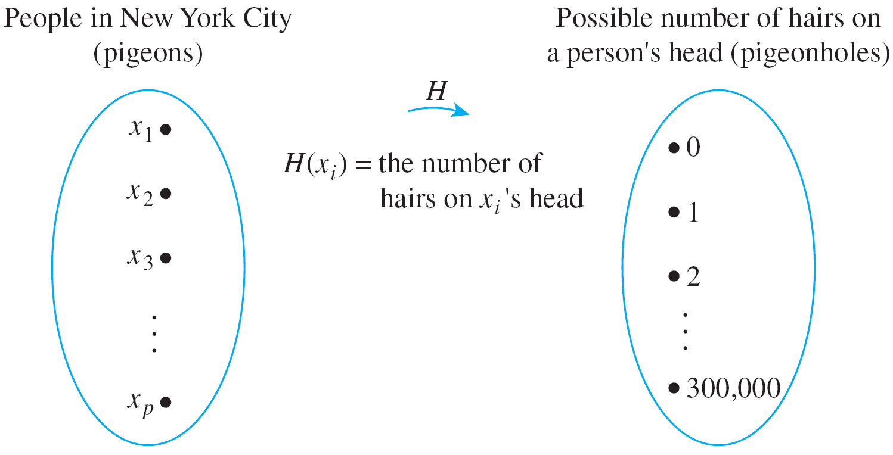
Example 1(b) – Solution
cont’d
Define a function H from the set of people in New York City {x₁, x₂, . . . , x_{p}} to the set {0, 1, 2, 3, . . . , 300 000}, as shown below.

Slide 11
Example 1(b) – Solution
cont’d
Since the number of people in New York City is larger than the number of possible hairs on their heads, the function H is not one-to-one; at least two arrows point to the same number.
But that means that at least two people have the same number of hairs on their heads.

Slide 12
Application to Decimal Expansions of Fractions

Slide 13
Application to Decimal Expansions of Fractions
One important consequence of the piegonhole principle is the fact that
the decimal expansion of any rational number either terminates or repeats.
A terminating decimal is one like
3.625,
and a repeating decimal is one like
2.38246,
where the bar over the digits 246 means that these digits are repeated forever.

Slide 14
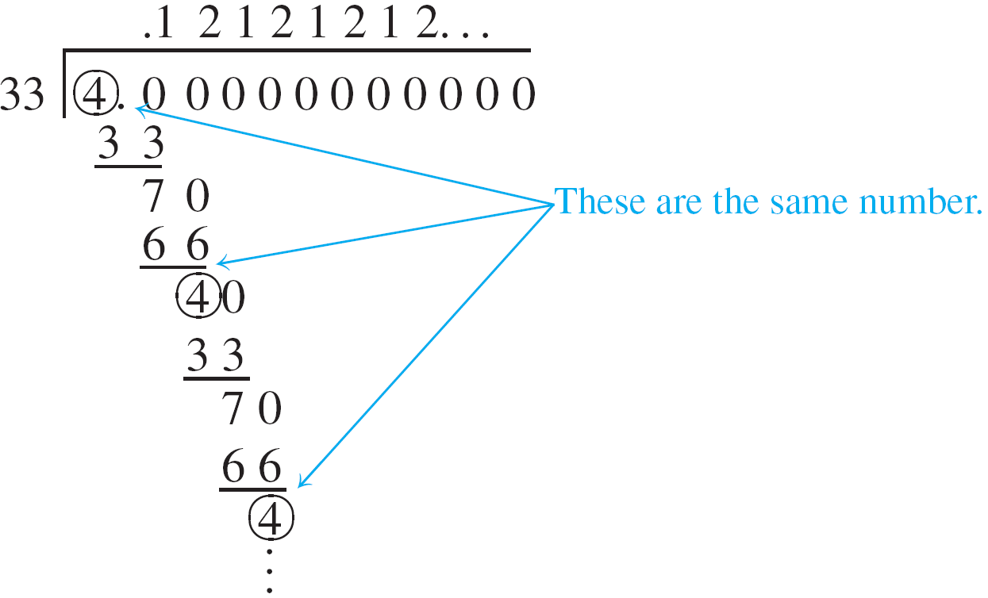
Application to Decimal Expansions of Fractions
A rational number is one that can be written as a ratio of integers—in other words, as a fraction.
The decimal expansion of a fraction is obtained by dividing its numerator by its denominator using long division. For example, the decimal expansion of 4/33 is obtained as follows:

Slide 15
Application to Decimal Expansions of Fractions
Because the number 4 reappears as a remainder in the long-division process, the sequence of quotients and remainders that give the digits of the decimal expansion repeats forever; hence the digits of the decimal expansion repeat forever.
In general, when one integer is divided by another, it is the pigeonhole principle (together with the quotient-remainder theorem) that guarantees that such a repetition of remainders and hence decimal digits must always occur.
This is explained in the next example.

Slide 16
Application to Decimal Expansions of Fractions
The analysis in the example uses an obvious generalization of the pigeonhole principle, namely that a function from an infinite set to a finite set cannot be one-to-one.

Slide 17
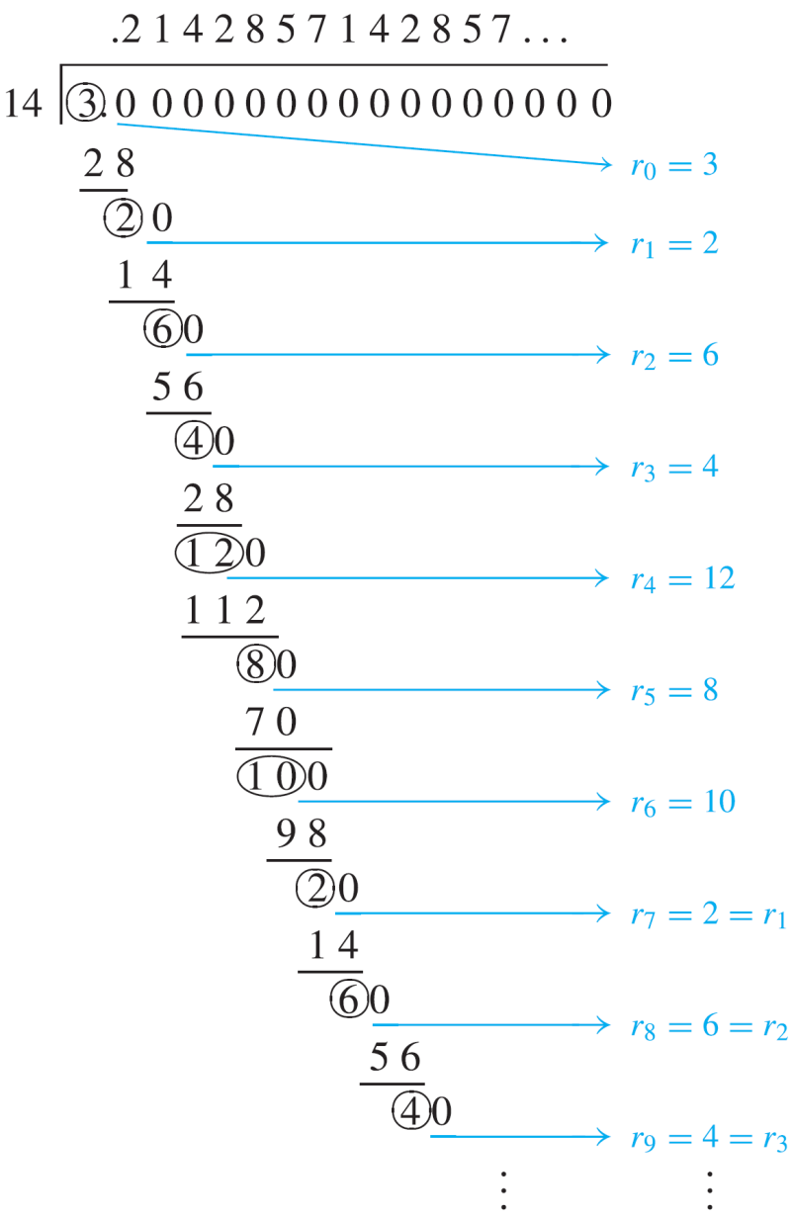
Example 4 – The Decimal Expansion of a Fraction
Consider a fraction a/b, where for simplicity a and b are both assumed to be positive.
The decimal expansion of a/b is
obtained by dividing the a by the
b as illustrated here for a = 3
and b = 14.

Slide 18
Example 4 – The Decimal Expansion of a Fraction
cont’d
Let r₀ = a and let r₁, r₂, r₃, . . . be the successive remainders obtained in the long division of a by b.
By the quotient-remainder theorem, each remainder must be between 0 and b – 1. (In this example, a is 3 and b is 14, and so the remainders are from 0 to 13.)
If some remainder r_{i} = 0, then the division terminates and a/b has a terminating decimal expansion. If no r_{i} = 0, then the division process and hence the sequence of remainders continues forever.

Slide 19
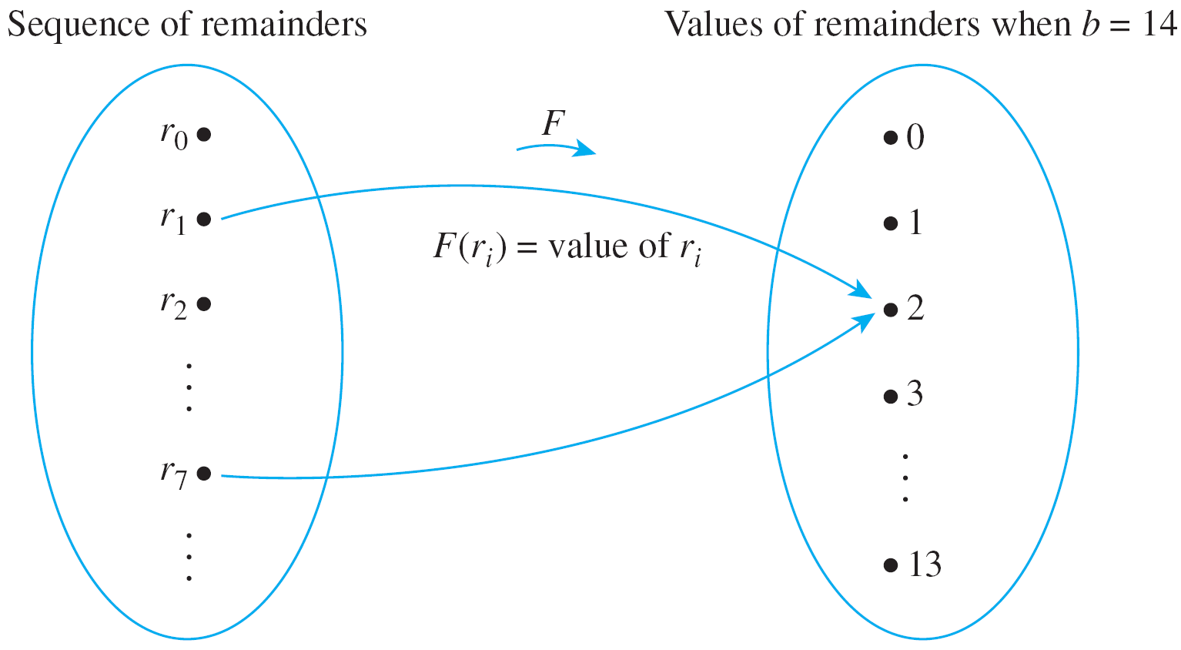
Example 4 – The Decimal Expansion of a Fraction
cont’d
By the pigeonhole principle, since there are more remainders than values that the remainders can take, some remainder value must repeat: r_{j} = r_{k}, for some indices j and k with j < k.
This is illustrated below for a = 3 and b = 14.

Slide 20
Example 4 – The Decimal Expansion of a Fraction
cont’d
If follows that the decimal digits obtained from the divisions between r_{j} and r_{k – 1} repeat forever.
In the case of 3/14, the repetition begins with r₇ = 2 = r₁ and the decimal expansion repeats the quotients obtained from the divisions from r₁ through r₆ forever:
3/14 = 0.2142857.

Slide 21
Generalized Pigeonhole Principle

Slide 22
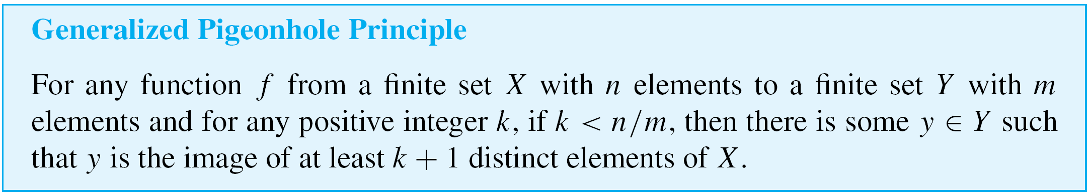
Generalized Pigeonhole Principle
A generalization of the pigeonhole principle states that if n pigeons fly into m pigeonholes and, for some positive integer k, k < n/m, then at least one pigeonhole contains
k + 1 or more pigeons.

Slide 23
Example 5 – Applying the Generalized Pigeonhole Principle
Show how the generalized pigeonhole principle implies that in a group of 85 people, at least 4 must have the same last initial.
Solution:
In this example the pigeons are the 85 people and the pigeonholes are the 26 possible last initials of their names. Note that
3 < 85/26 ≅ 3.27.

Slide 24
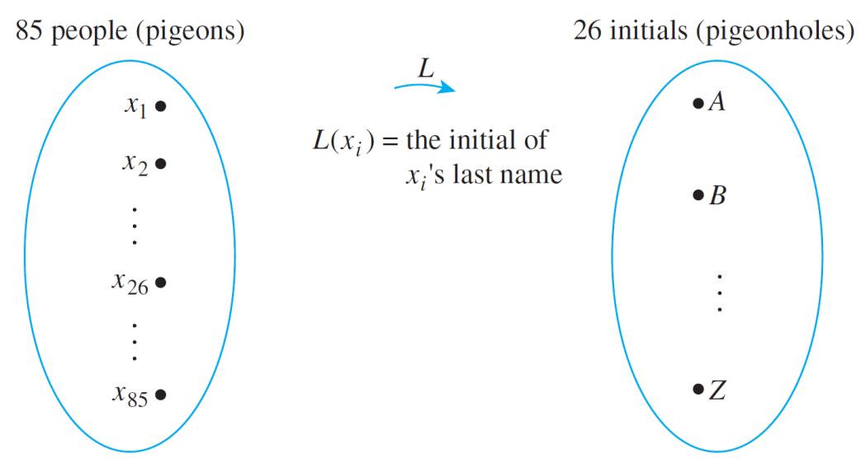
Example 5 – Solution
cont’d
Consider the function L from people to initials defined by the following arrow diagram.
Since 3 < 85/26, the generalized pigeonhole principle states that some initial must be the image of at least four
(3 + 1) people.
Thus at least four people have the same last initial.

Slide 25
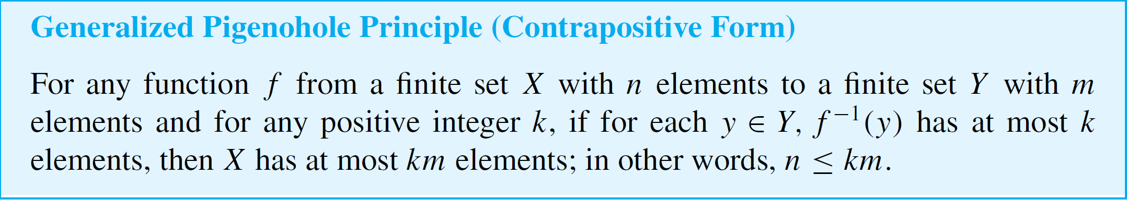
Generalized Pigeonhole Principle
Consider the following contrapositive form of the generalized pigeonhole principle.
You may find it natural to use the contrapositive form of the generalized pigeonhole principle in certain situations.

Slide 26
Generalized Pigeonhole Principle
For instance, the result of Example 5 can be explained
as follows:
Suppose no 4 people out of the 85 had the same last initial. Then at most 3 would share any particular one.
By the generalized pigeonhole principle (contrapositive form), this would imply that the total number of people is at most 3  26 = 78. But this contradicts the fact that there are 85 people in all.
Hence at least 4 people share a last initial.

Slide 27
Example 6 – Using the Contrapositive Form of the Generalized Pigeonhole Principle
There are 42 students who are to share 12 computers. Each student uses exactly 1 computer, and no computer is used by more than 6 students. Show that at least 5 computers are used by 3 or more students.

Slide 28
Example 6(a) – Solution
cont’d
Using an Argument by Contradiction: Suppose not. Suppose that 4 or fewer computers are used by 3 or more students. [A contradiction will be derived.] Then 8 or more computers are used by 2 or fewer students.
Divide the set of computers into two subsets: C₁ and C₂.

Slide 29
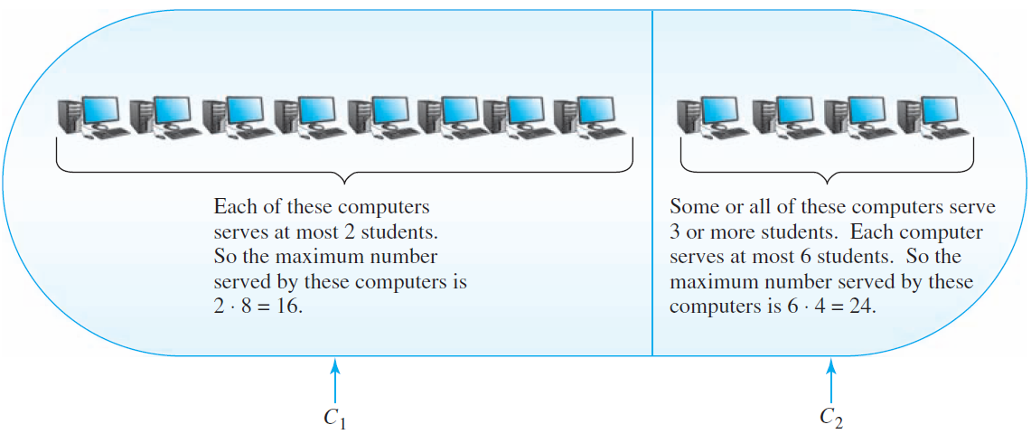
Example 6(a) – Solution
cont’d
Into C₁ place 8 of the computers used by 2 or fewer students; into C₂ place the computers used by 3 or more students plus any remaining computers (to make a total of 4 computers in C₂). (See Figure 9.4.3.)
The set of 12 computers
Figure 9.4.3

Slide 30
Example 6(a) – Solution
cont’d
Since at most 6 students are served by any one computer, by the contrapositive form of the generalized pigeonhole principle, the computers in set C₂ serve at most
6  4 = 24 students.
Since at most 2 students are served by any one computer in C₁, by the generalized pigeonhole principle (contrapositive form), the computers in set C₁ serve at most 2  8 = 16 students.

Slide 31
Example 6(a) – Solution
cont’d
Hence the total number of students served by the computers is 24 + 16 = 40.
But this contradicts the fact that each of the 42 students is served by a computer.
Therefore, the supposition is false: At least 5 computers are used by 3 or more students.

Slide 32
Example 6(b) – Solution
cont’d
Using a Direct Argument: Let k be the number of
computers used by 3 or more students. [We must show that k ≥ 5.]
Because each computer is used by at most 6 students, these computers are used by at most 6k students (by the contrapositive form of the generalized pigeonhole principle).
Each of the remaining 12 – k computers is used by at most 2 students.

Slide 33
Example 6(b) – Solution
cont’d
Hence, taken together, they are used by at most
2(12 – k) = 24 – 2k students (again, by the contrapositive form of the generalized pigeonhole principle).
Thus the maximum number of students served by the computers is 6k + (24 – 2k) = 4k + 24.
Because 42 students are served by the computers,
4k + 24 ≥ 42.
Solving for k gives that k ≥ 4.5, and since k is an integer, this implies that k ≥ 5 [as was to be shown].

Slide 34
Proof of the Pigeonhole Principle

Slide 35
Proof of the Pigeonhole Principle
The truth of the pigeonhole principle depends essentially on the sets involved being finite.
We have known that a set is called finite if, and only if, it is the empty set or there is a one-to-one correspondence from {1, 2, . . . , n} to it, where n is a positive integer.
In the first case the number of elements in the set is said to be 0, and in the second case it is said to be n. A set that is not finite is called infinite.
Thus any finite set is either empty or can be written in the form {x₁, x₂, . . . , x_{n}} where n is a positive integer.

Slide 36
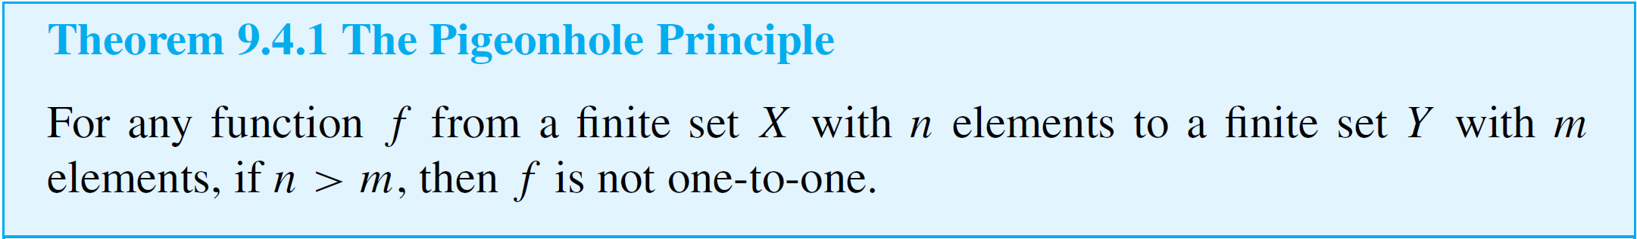
Proof of the Pigeonhole Principle
Proof:
Suppose f is any function from a finite set X with n elements to a finite set Y with m elements where n > m. Denote the elements of Y by y₁, y₂, . . . , y_{m}.
We have known that for each y_{i} in Y, the inverse image set

Slide 37

Proof of the Pigeonhole Principle
Now consider the collection of all the inverse image sets for all the elements of Y:
By definition of function, each element of X is sent by f to some element of Y. Hence each element of X is in one of the inverse image sets, and so the union of all these sets equals X.
But also, by definition of function, no element of X is sent by f to more than one element of Y.
Thus each element of X is in only one of the inverse image sets, and so the inverse image sets are mutually disjoint.

Slide 38

Proof of the Pigeonhole Principle
By the addition rule, therefore,
Now suppose that f is one-to-one [which is the opposite of what we want to prove].
Then each set has at most one element, and so

Slide 39
Proof of the Pigeonhole Principle
Putting equations (9.4.1) and (9.4.2) together gives that
n = N(X ) ≤ m = N(Y ).
This contradicts the fact that n > m, and so the supposition that f is one-to-one must be false.
Hence f is not one-to-one [as was to be shown].

Slide 40
Proof of the Pigeonhole Principle
An important theorem that follows from the pigeonhole principle states that a function from one finite set to another finite set of the same size is one-to-one if, and only if, it is
onto.
As we have known, this result does not hold for infinite sets.

Slide 41
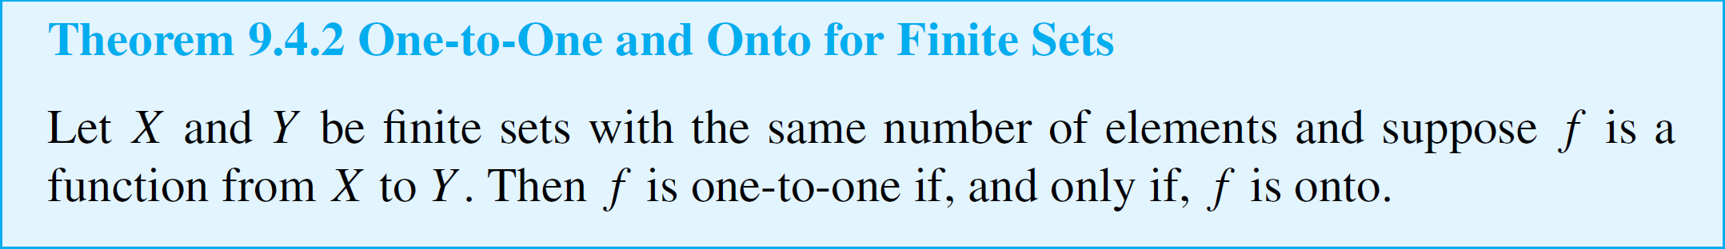
Proof of the Pigeonhole Principle
Note that Theorem 9.4.2 applies in particular to the case
X = Y.
Thus a one-to-one function from a finite set to itself is onto, and an onto function from a finite set to itself is one-to-one.
Such functions are permutations of the sets on which they are defined.

Slide 42
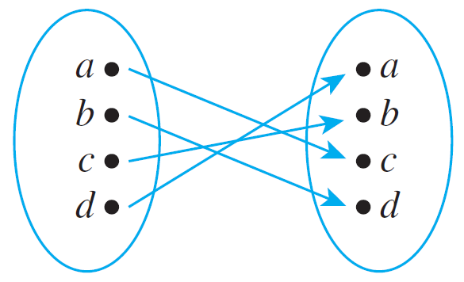
Proof of the Pigeonhole Principle
For instance, the function defined by the diagram below, is another representation for the permutation cdba obtained by listing the images of a, b, c, and d in order.

